Slide 1
Heartbeat Monitoring System
Utkarsh Sahaya 2019168
Shrestha Pratap Singh 2019147
Simran Simoliya 2019153
Umesh Kushwaha 2019167

Slide 2
Contents
Introduction
About the project
Hardware components Required
Software components Required
Circuitry
Block diagram
Code implementation
Flow chart of code
Further extension
Video of Simulation
Conclusion

Slide 3

Introduction
Heart is one of the most important organs in the body.
It is also the organ which causes the most number of deaths. In fact worldwide “Cardiovascular disease” are the cause of most number of deaths, and out of which 80% of are due to coronary heart attack.
This makes regular heart monitoring very important.
The problem is that it is not feasible for people to go to hospital for daily checkup. Hence a system should be made which makes heart monitoring possible at home and also without requirement of medical professional.
It should be easy to use, yet highly accurate.

Slide 4
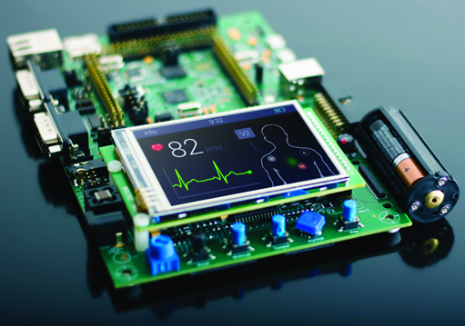
About The Project
Embedded Systems can be used as a solution to have accurate and easy to use device for heart monitoring.
Wi-Fi module like ESP8266 could be used which would allow the data to be sent on a remote server.
The data sent on a remote server could be stored, exported, visualized and analyzed graphically.
Various machine learning algorithms can be used to draw insights on the data recorded over a period of time.

Slide 5
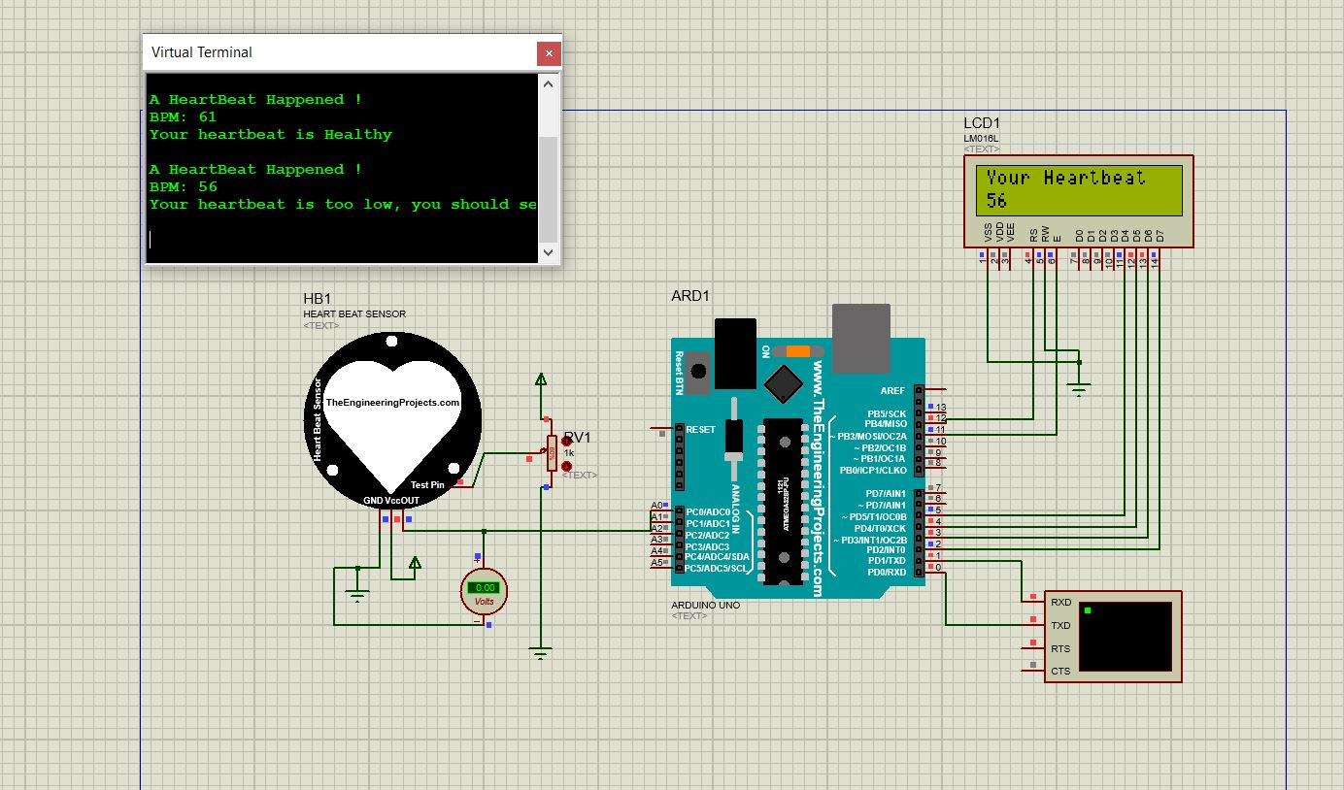
Online Simulation intricacy
Because of lack of hardware components. The project is simulated in Proteus software.
However the Wi-Fi segment of the process could not be simulated in that environment too.
Since actual heartbeat cannot be made in simulation, therefore a variable resistor is used which varies the resistance, causing different values of heartbeat.
The data of heartbeat recorded through Proteus is manually sent to Tinkercad where further things are done like measuring body temperature and effective warning system.

Slide 6
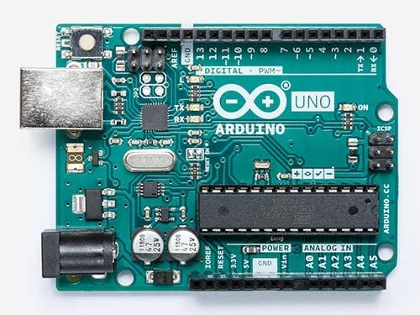
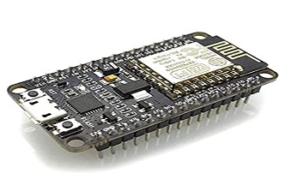
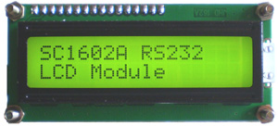
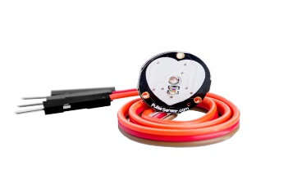
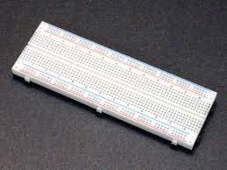
Hardware Components Required
Microcontroller (Arduino Uno) | The main processing unit of the project
ESP8266 Wi-Fi module | It gives Wi-Fi access to the microcontroller
LCD display | To display data observed and inferences relating to data.
Heart Beat sensor | To measure heart beat
Breadboard | To put all circuitry properly

Slide 7
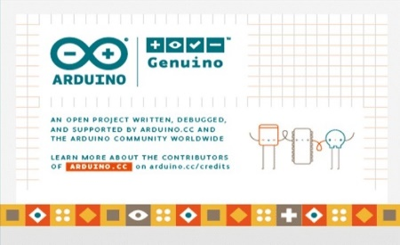
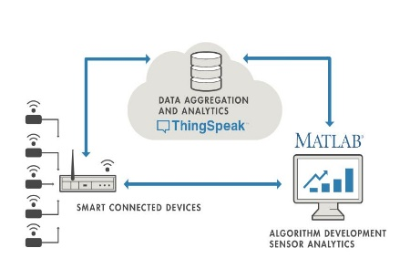


Software Components Required
Arduino IDE | An open source IDE that allows to write and upload code to the Arduino board
ThinkSpeak | An IOT analytics platform which allows to store, export, visualize and analyze live data.
Proteus Circuit Simulator Software | Due to lack of physical components the simulation of project is done in this software
MIT App Inventor | Easy app making environment. The app will give accessibility of data on any internet connected device

Slide 8
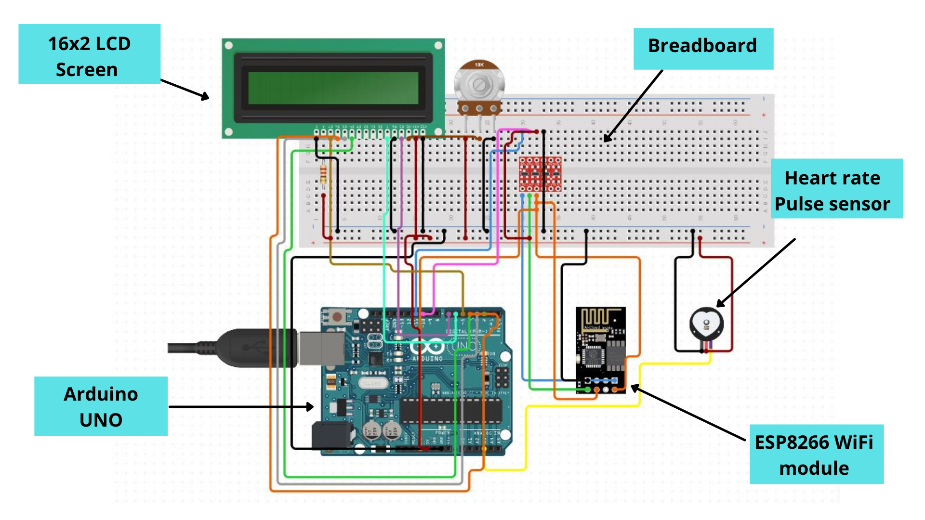
Circuitry

Slide 9
Block Diagram
ESP8266
Heartbeat Pulse Sensor
ARDUINO UNO
ThingSpeak
LCD Screen
Analytics
Export
Visualization

Slide 10
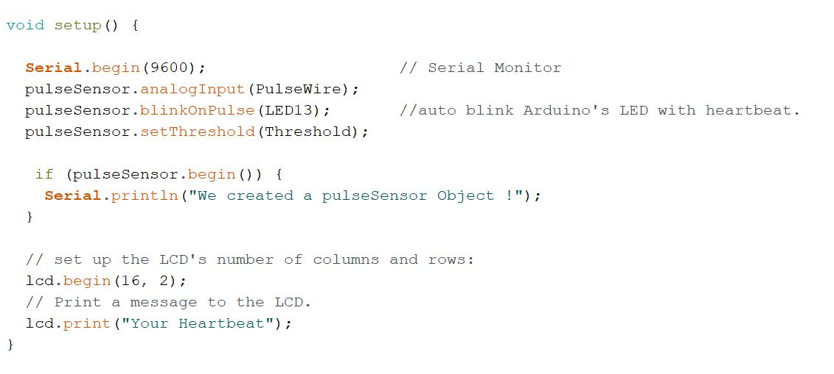
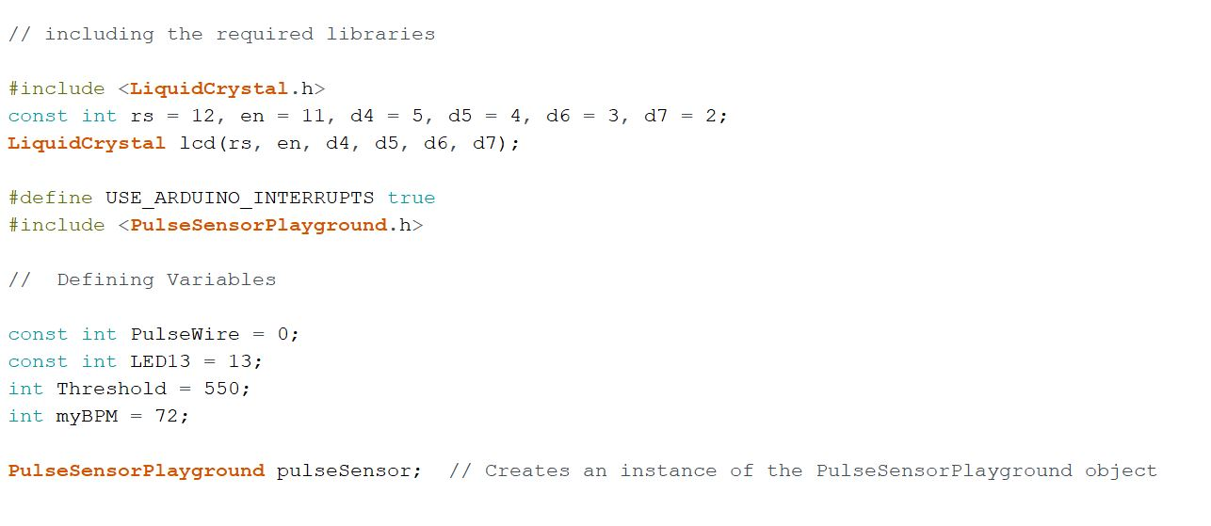
Code Implementation
2.
1.

Slide 11
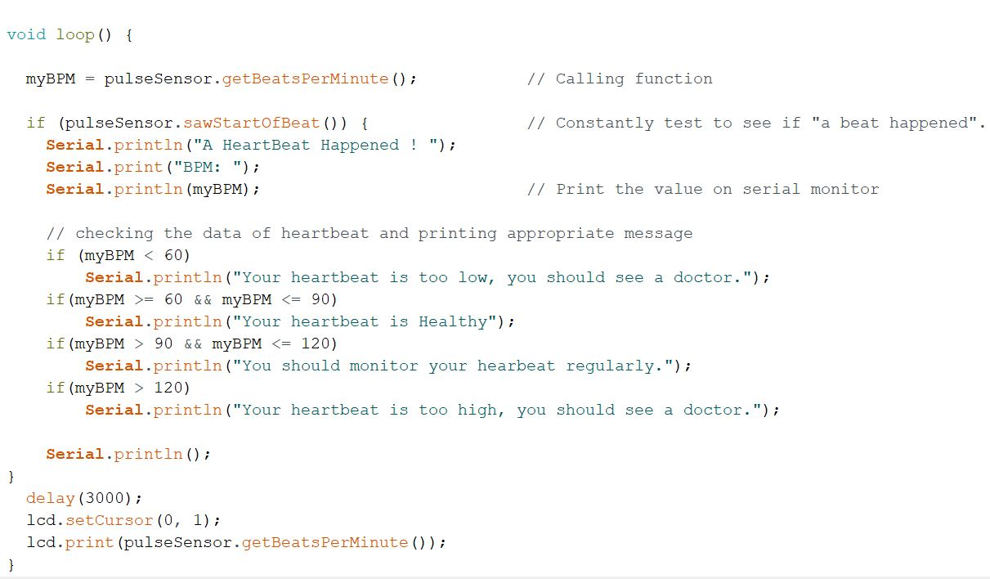
Code Implementation
3.

Slide 12
Flowchart of code
START
Initialize microcontroller
False
Check Wi-Fi status connection
END
Send warning in some form
True
Initialize sensors
If data value indicates of abnormal values
Read data from Heart beat pulse sensor
Send data to ThinkSpeak and App

Slide 13
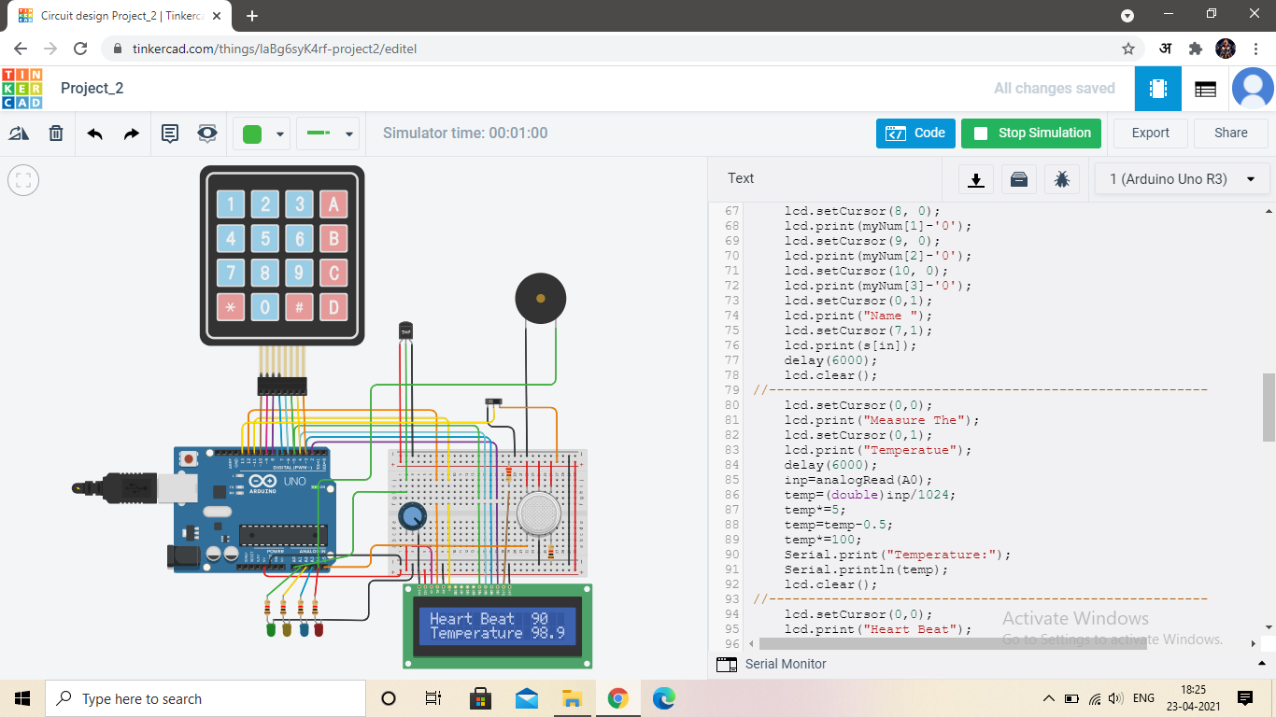
Further extension
For further extension of the project we sent the recorded data of heartbeat manually from Proteus software to Tinkercad.
In Tinkercad we further measured the body temperature and depending on the values print appropriate message.
Data of heartbeat together with body temperature and blood oxygen level will give complete results covering almost every aspect.

Slide 14
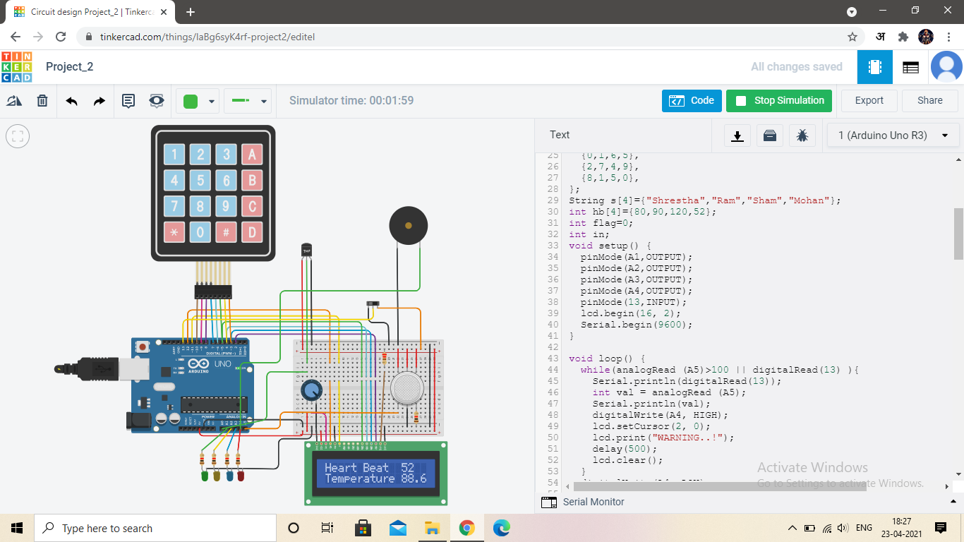


Further extension
Displaying heartbeat and temperature
Printing appropriate message
Printing appropriate message along with buzzer warning

Slide 15
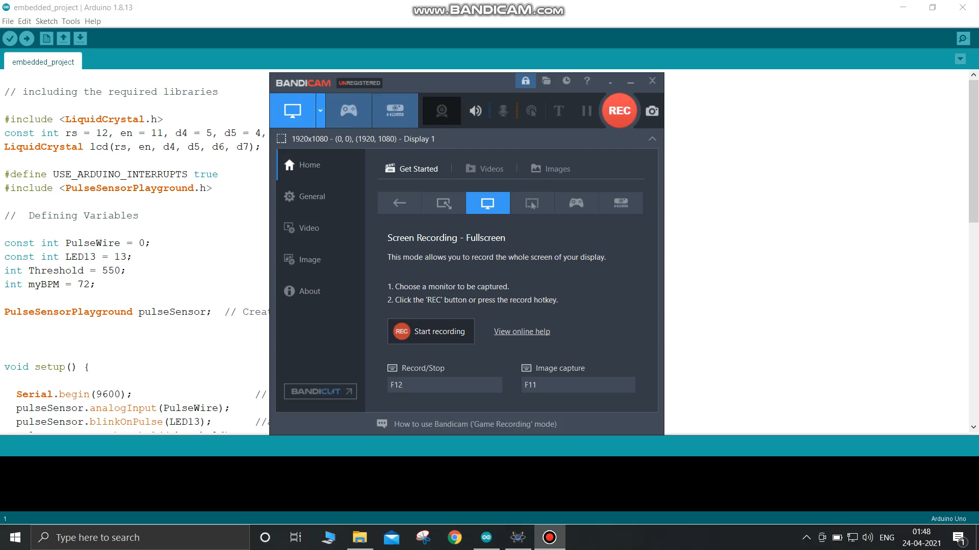
A very quick Simulation video on Proteus

Slide 16
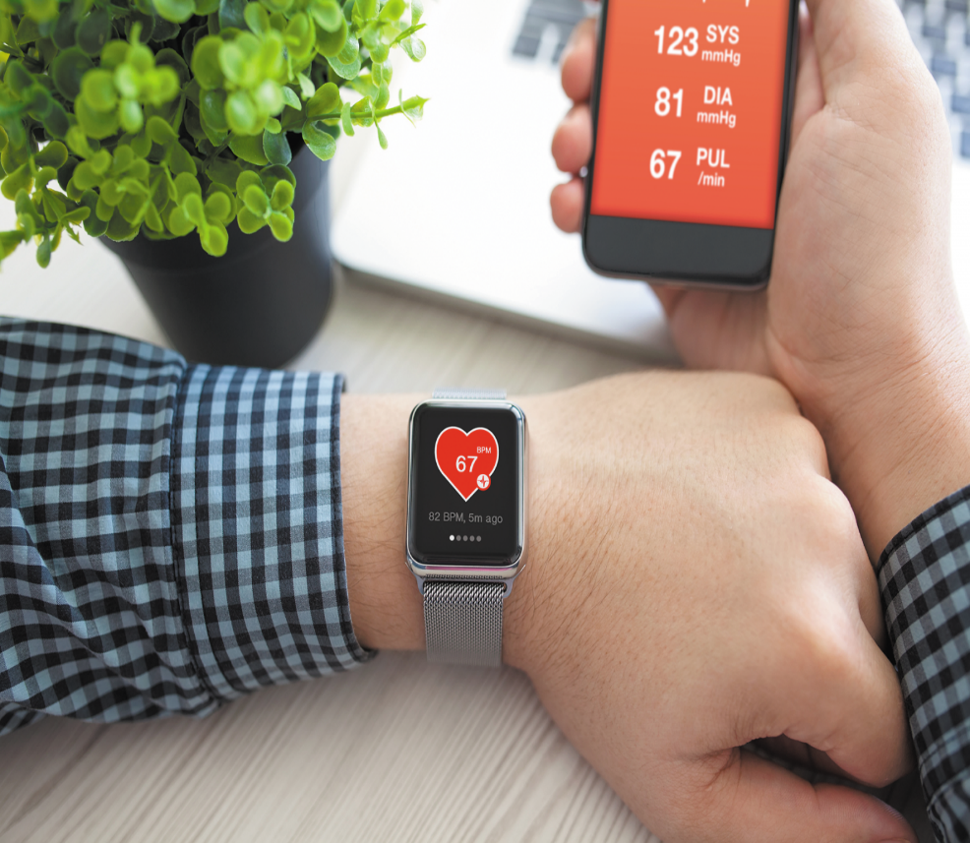
Conclusion
Having an embedded system which could monitor health of heart regularly could be life saving.
In this covid times SPO2 monitoring devices which are actually an embedded system proved how beneficial these devices could be. It allowed people to regularly monitor their blood oxygen level at their home.
The advantages of these embedded system is that they are highly portable, accurate to a very high degree and require very less power to run.
IoT technology is taking the monitoring to the next level where the recorded data is stored, which makes analysis of long term data possible which is not possible in conventional devices.

Slide 17
End Of Presentation
“Thankyou”
Utkarsh Sahaya
2019168
Shrestha Pratap Singh
2019147
Simran Simoliya
2019153
Umesh Kushwaha
2019167

